Slide 1
Improvement of Lithium- Sulfur Fiber (Li-S) Batteries
Faculty Advisors: Dr. Shanov and Dr. Alvarez
GRA: Yanbo Fang
Presenters: Megan Stafford and Aaron Debbink
RET is funded by the National Science Foundation, grant EEC #17110826

Slide 2
TABLE OF CONTENTS
Why Advanced Batteries
Introduction of Lab Goals
Abstract
Background Literature Review
RET Goals and Objectives
Research Training Received
Research Results
Unit Topic, Essential Question and Challenge
Notes:
Megan

Slide 3
Connected Devices
for each Person Worldwide
1.84
6.58
2010
2020
3.64
2018
“Forecast on connected devices per person worldwide 2003-2020 | Statistic.” (2016). Statista, PwC, <https://www.statista.com/statistics/678739/forecast-on-connected-devices-per-person/> (Jul. 5, 2018).
Notes:
Megan
Emphasize wearable to lead into fiber battery
3.64 presently: https://blog.globalwebindex.com/chart-of-the-day/digital-consumers-own-3-64-connected-devices/

Slide 4
LAB GOALS
Develop sensors using carbon nanostructures
Develop and test energy-dense supercapacitors using carbon nanostructures
Develop and test energy-dense batteries using carbon nanostructures
Notes:
Aaron

Slide 5
ABSTRACT
Interest in the development of energy-dense fiber batteries.
Lithium-sulfur batteries offer a high theoretical energy density but have major limitations.
Develop a highly conductive, mechanically strong cathode which can be used in a fiber battery.
Notes:
Aaron
1) (RET) Higher conductivity (resistivity) and mechanically stronger (tensile tester) substrate for the S-CNT cathode to be used for the Li-S fiber battery.
S-CNT allows the battery to have a high capacity
Densified CNT gives the cathode a higher conductivity and mechanical strength.
2) (Maybe) Test effect of gel electrolyte and change components of gel electrolyte for better ion transfer rates and faster reaction kinetics. This must be addressed since previous charging at higher currents…
>> to limit polysuflide shuttling and faster...

Slide 6
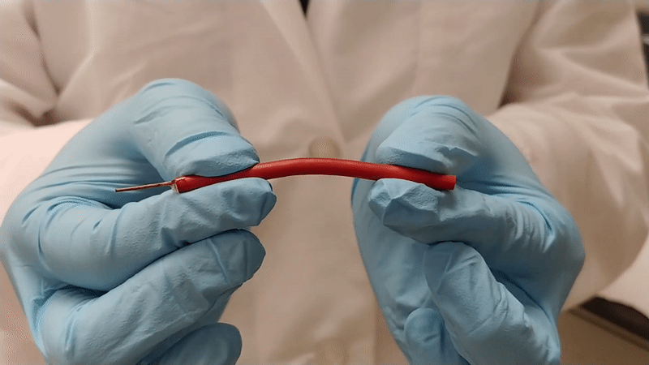
FIBER BATTERY
Notes:
Megan
Introduction to what a fiber battery is with need to be flexible with emphasis on wearable technology

Slide 7
LITHIUM
SULFUR
BATTERIES
Benefits
High theoretical capacity to store electric charge (1675 mA h g⁻¹)
One of the most abundant elements, economical
Environmentally friendly
Limitations
Low conductivity
Low tensile strength
Fragile
Chung, S., Manthiram, A., Zu, C. (2015). “Lithium-Sulfur Batteries: Progress and Prospects.” Advanced Materials, 27, 1980-2006
Notes:
Megan
1) (RET) Higher conductivity (resistivity) and mechanically stronger (tensile tester) substrate for the S-CNT cathode to be used for the Li-S fiber battery.
S-CNT allows the battery to have a high capacity
Densified CNT gives the cathode a higher conductivity and mechanical strength.
2) (Maybe) Test effect of gel electrolyte and change components of gel electrolyte for better ion transfer rates and faster reaction kinetics. This must be addressed since previous charging at higher currents…
>> to limit polysuflide shuttling and faster...

Slide 8
CATHODE DESIGN
= Sulfur clusters/agglomerates
= Carbon Nanotube
Notes:
Aaron
Use manipulative: sulfur low conductivity and is brittle and must be able to withstand deformations. Sulfur needs encapsulated inside of CNT (explain a CNT).

Slide 9
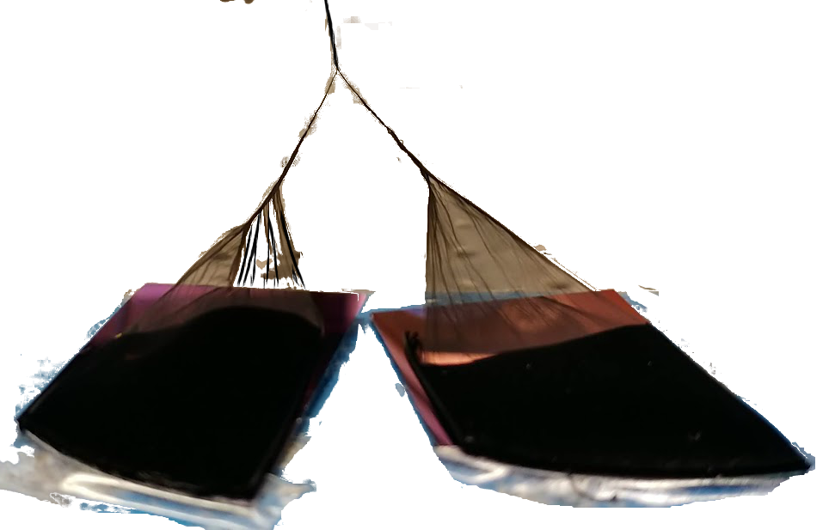
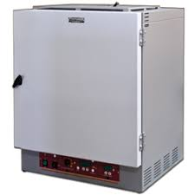
BATTERY ASSEMBLY
Carbon Nanotube Array
Fiber CNT Spinning
O₂ Plasma Functionalization
He
O
2
Sulfur Melting Infiltration Synthesis
Coin Cell Assembly
CNT + S
@ 155℃
Schematic illustration of the fabrication of a CNT-sulfur composite battery
Notes:
Aaron
think about who our audience is: non-scientists

Slide 10
GOALS
AND
OBJECTIVES
Create a hybrid carbon nanotube (CNT) thread using sulfur-loaded CNT and a densified CNT to increase conductivity and tensile strength.
Use the hybrid thread as the cathode in the assembly of a lithium sulfur fiber battery.
Notes:
Megan

Slide 11
RESEARCH TIMELINE
Hybrid thread assembly
Begin research paper
Lab Training:
Equipment and Characterization
Tensile strength testing
Finish research paper
03
05
01
Literature
Review
Lab Training:
Construct cathode and coin cells
Analyze battery results
Assemble additional coin cell batteries for testing
02
04
06
Notes:
Megan

Slide 12
HYBRID CATHODE
Hybrid CNT Thread
Sulfur CNT Thread
Densified CNT Thread
Notes:
Aaron

Slide 13
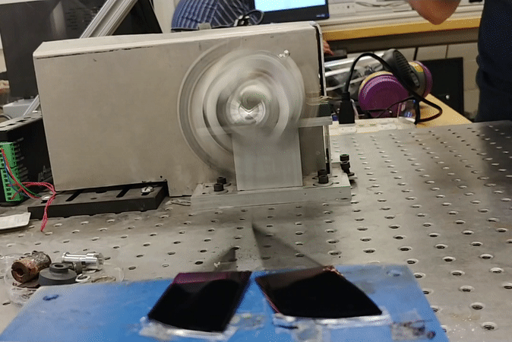
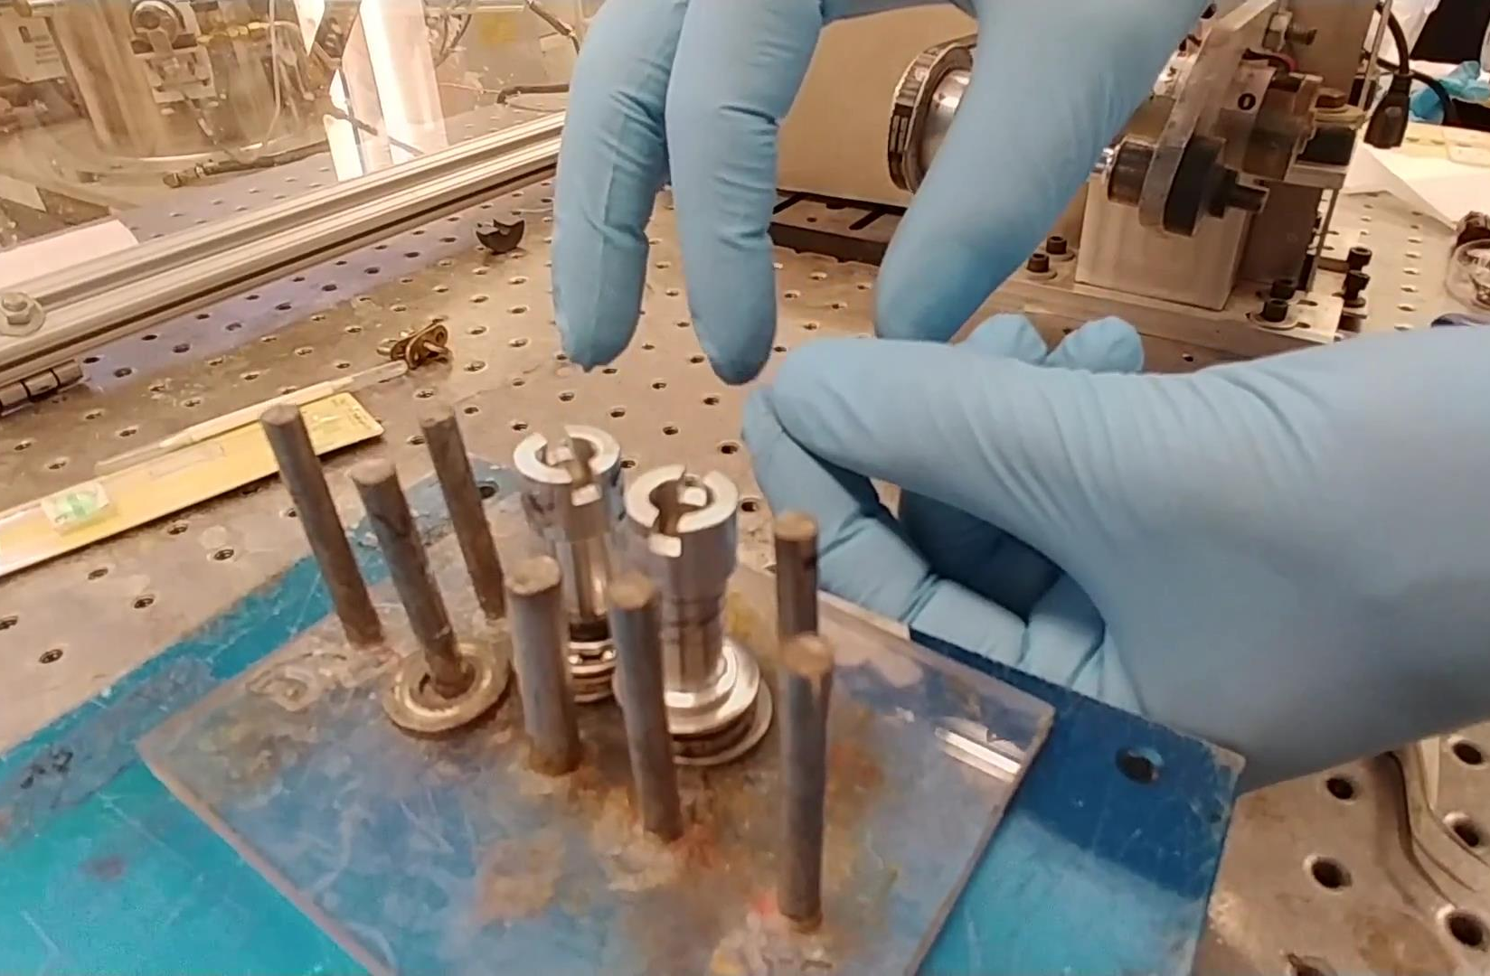
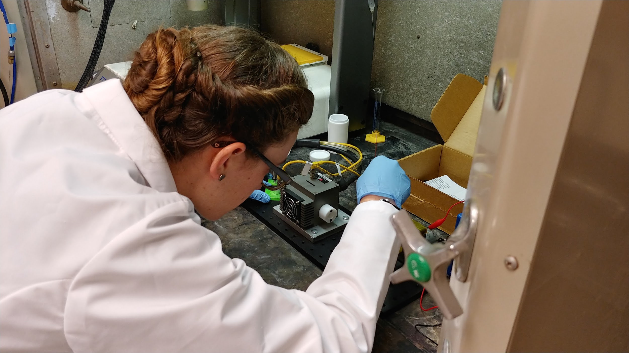
RESEARCH
TRAINING
ASSEMBLY
CNT Array spun into CNT thread
Winding Hybrid CNT Cathode
RET Teacher preparing CNT thread for Oxygen Plasma Functionalization
Autoclave containing CNT thread and Sulfur
Notes:
Aaron
Change CNT to hydrophilic to help ease Sulfur loading
Introduce defects to the CNT to help Sulfur load to the outside and inside of the CNT

Slide 14
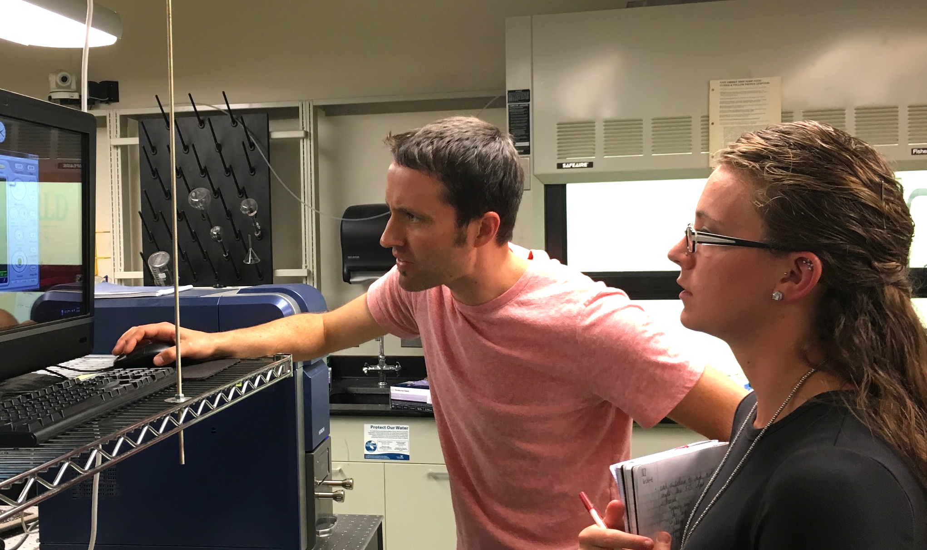
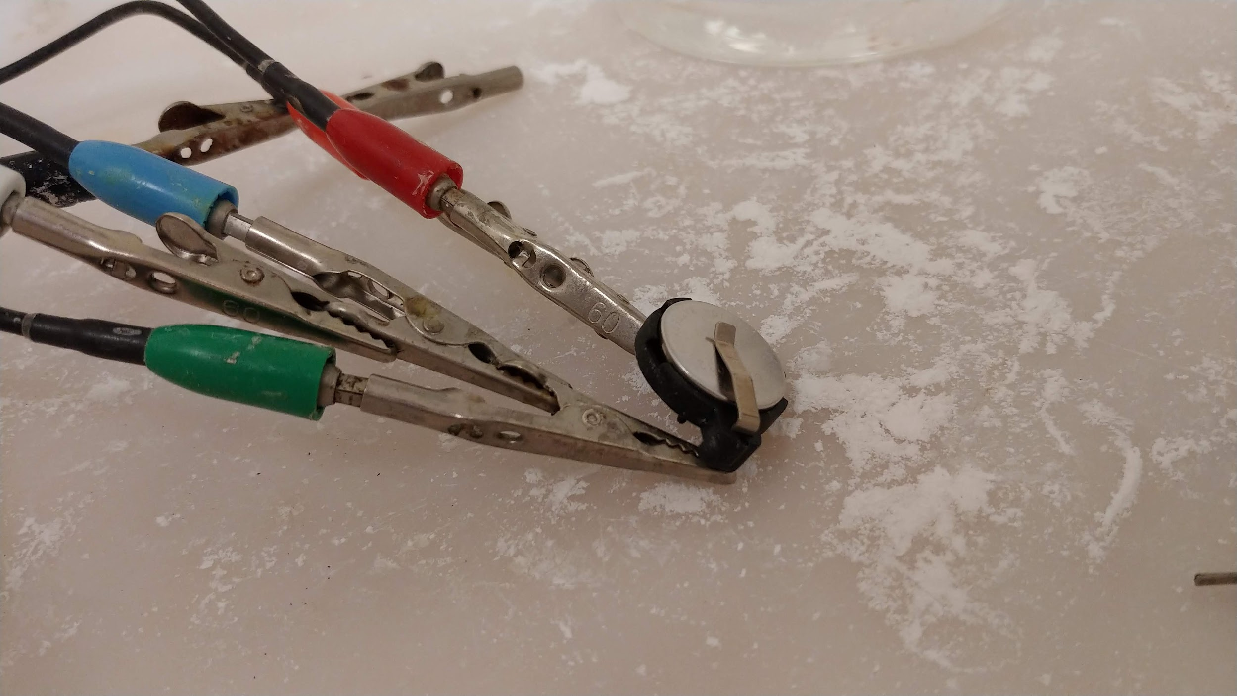
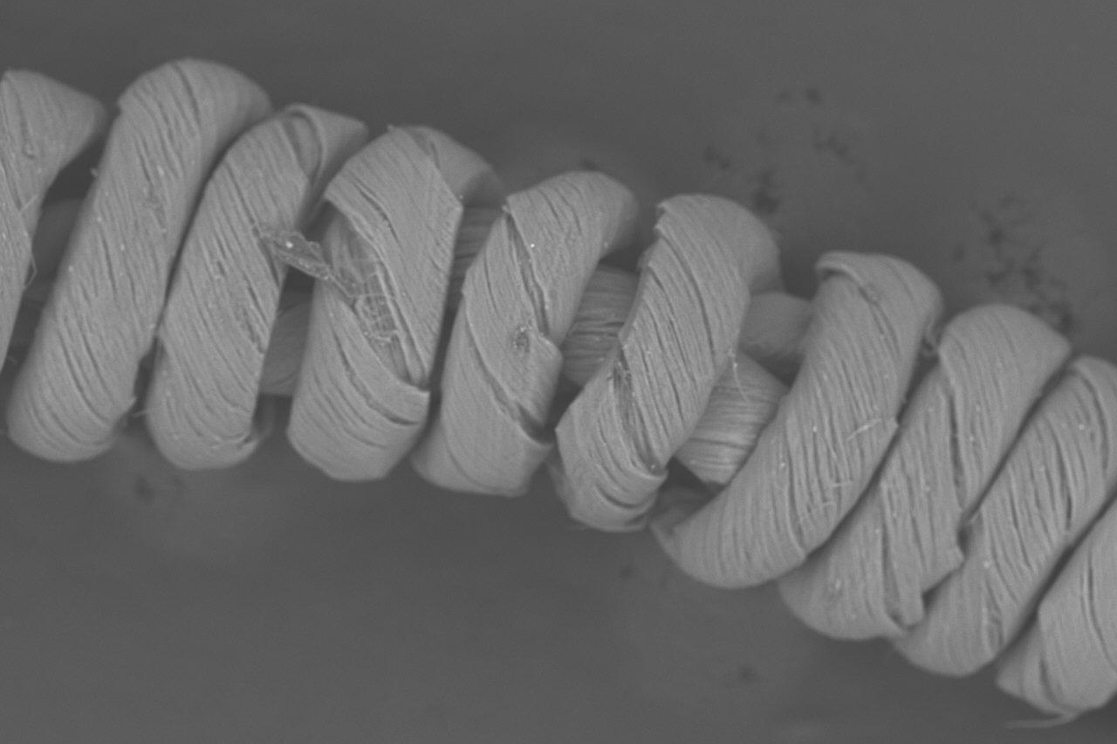
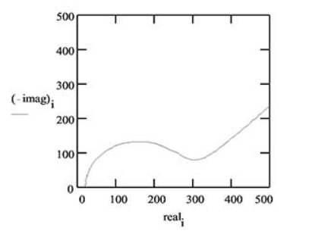
RESEARCH
TRAINING
CHARACTERIZATION
RET Teachers viewing CNT thread on SEM
Coin Cell Testing with E.I.S.
R = ?x
500x
SEM showing hybrid CNT thread
Nyquist Plot of Impedance
Notes:
Megan
Change CNT to hydrophilic to help ease Sulfur loading
Introduce defects to the CNT to help Sulfur load to the outside and inside of the CNT
Uses different charging frequencies to measure electrochemical cell properties: resistance and ion conductivity.

Slide 15
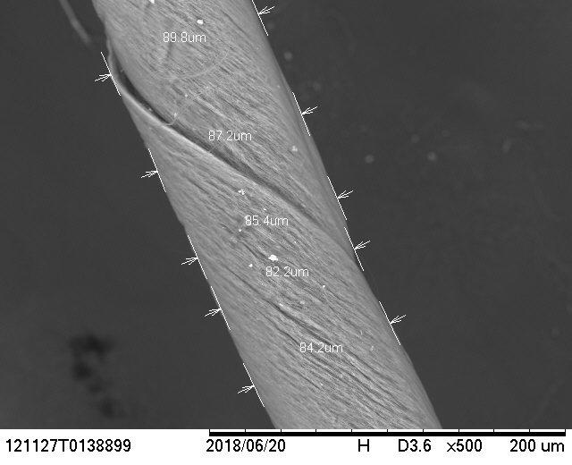
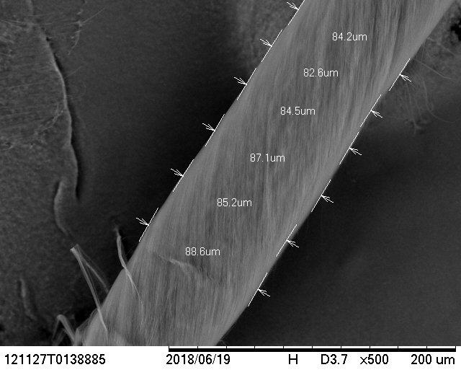
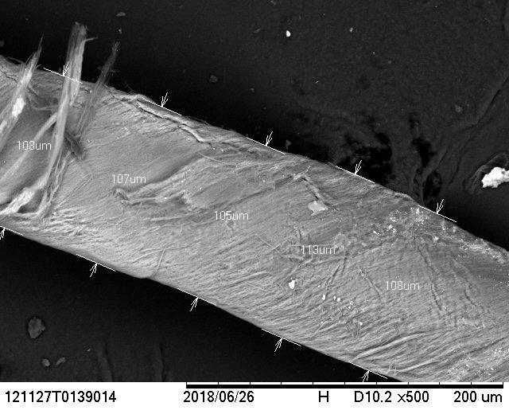
RESEARCH RESULTS
Sulfur- Loaded CNT Threads
63.4% Sulfur
57.4% Sulfur
66.5% Sulfur
Diameter: ~86 μm
Diameter: ~85 μm
Diameter: ~107 μm
Notes:
Aaron

Slide 16
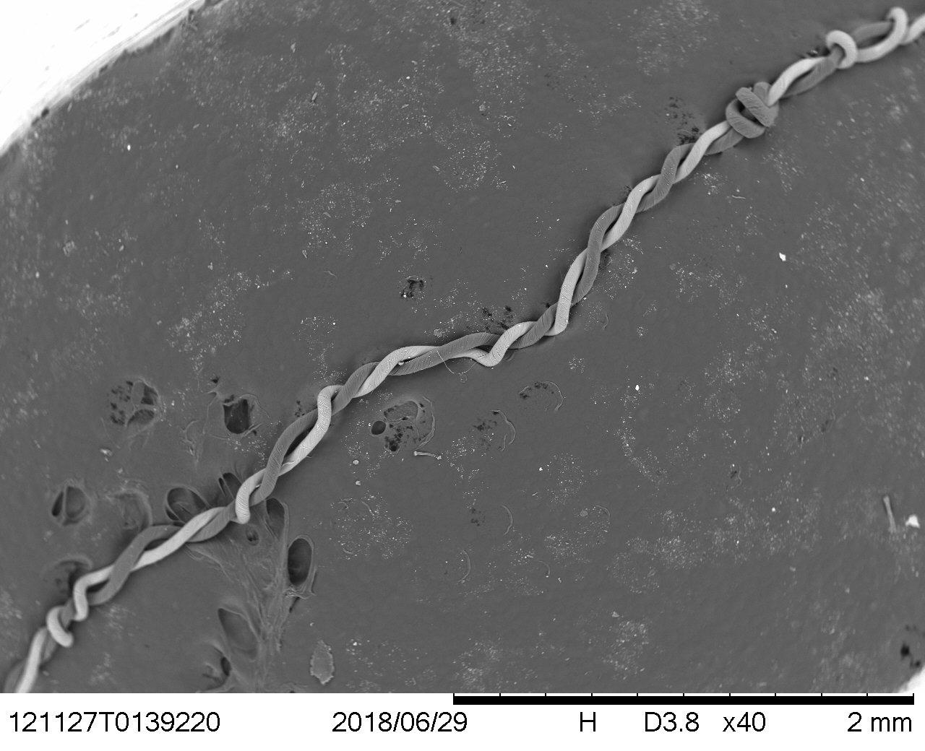
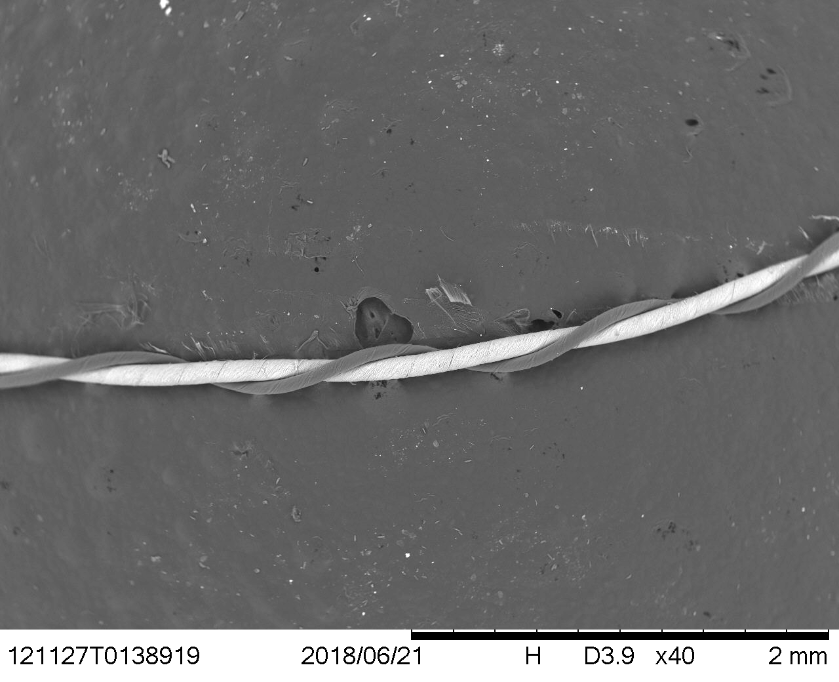
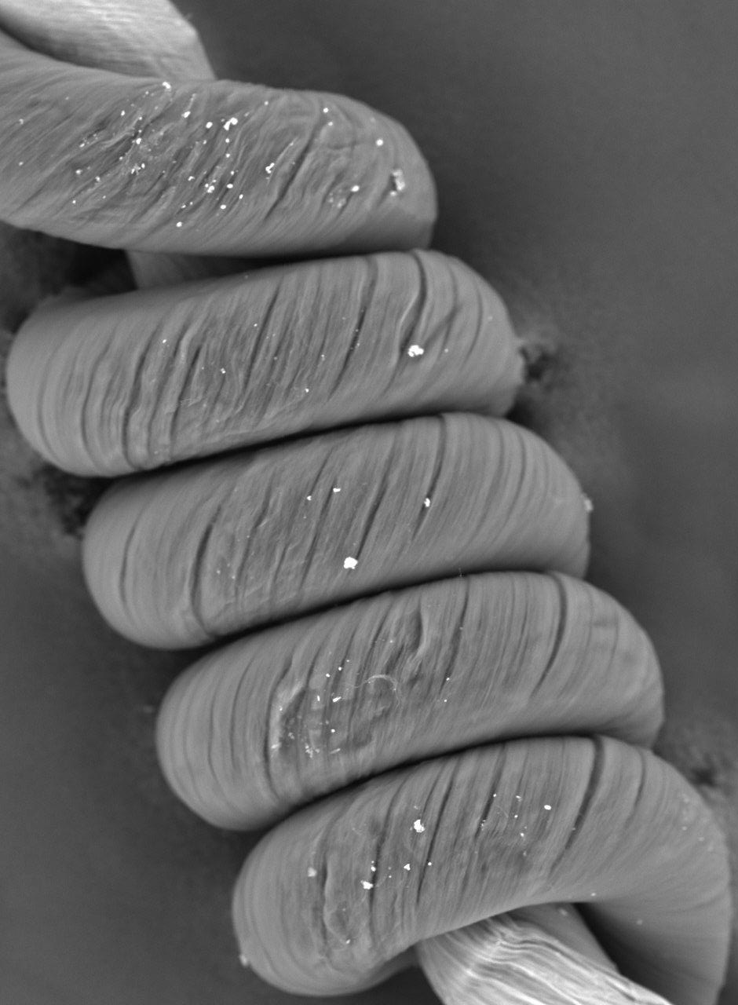
HYBRID
THREAD
ASSEMBLY
a)
b)
S-CNT
D-CNT
Hybrid CNT threads.
a) pulling rate of 1.6 mm/s and a spinning rate of 1,060rpm.
b) pulling rate of 1.9 mm/s and a spinning rate of 1,310 rpm.
c)pulling rate of 1.2 mm/s and a spinning rate of 1,310 rpm
c)
Notes:
Megan
Assembly of Hybrid Cathode: Attempted different spinning techniques by varying linear feed and rotation rates.

Slide 17
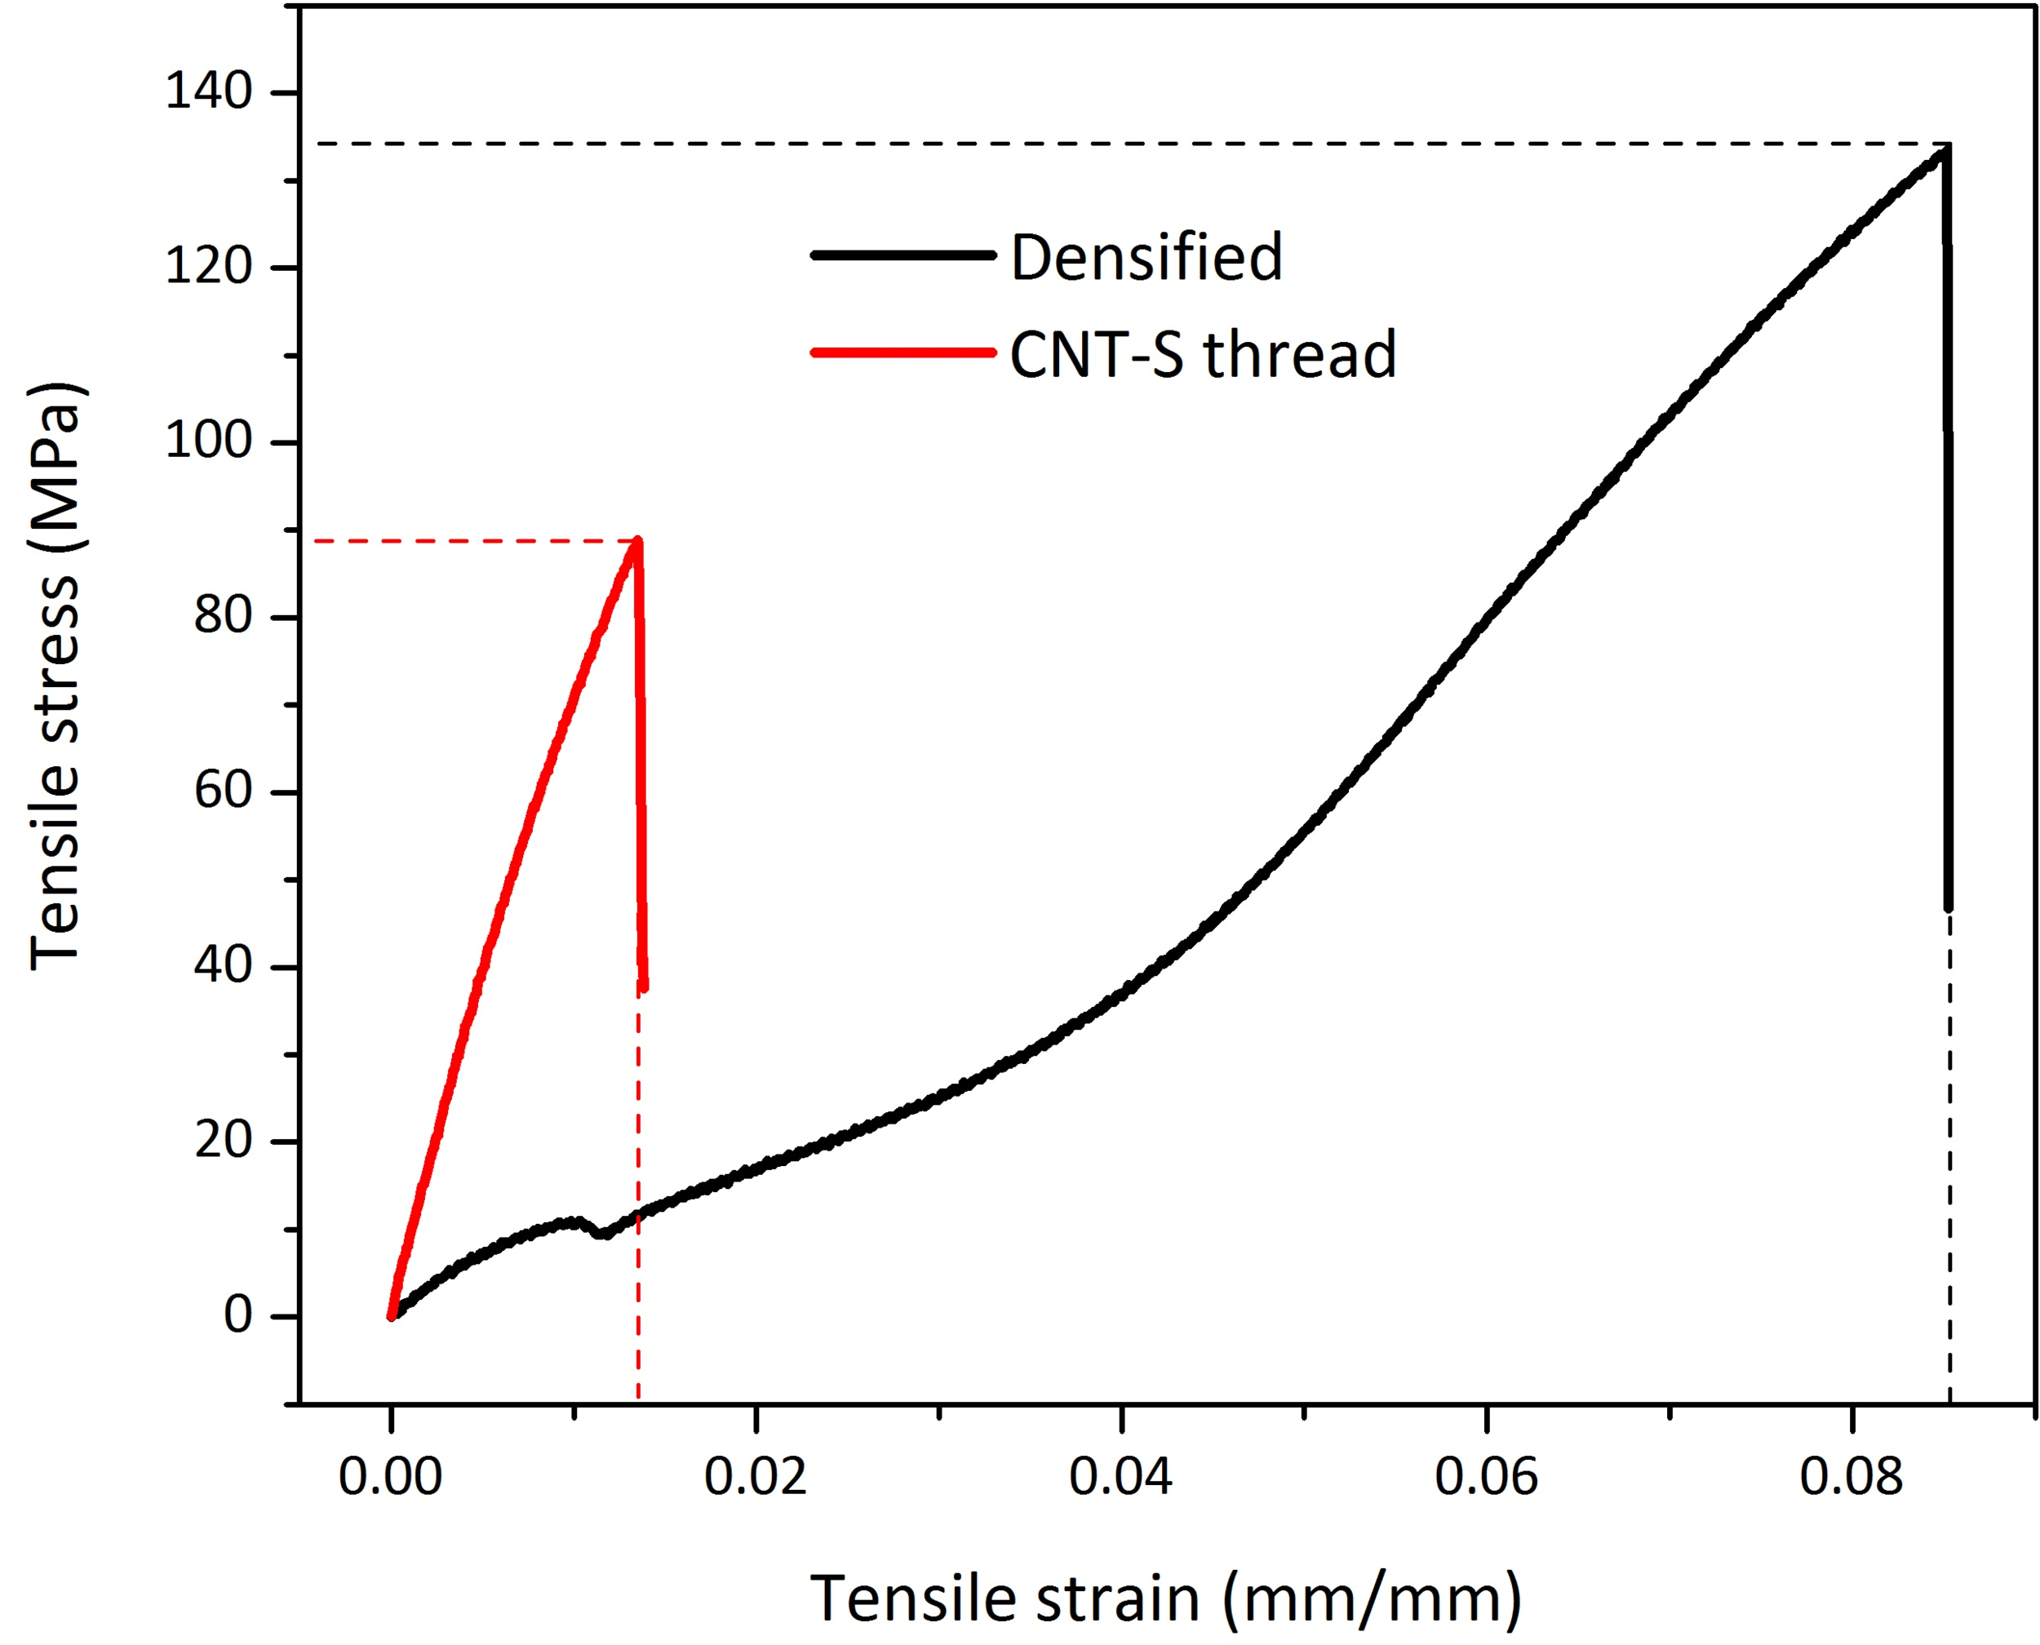
Tensile Testing Results
densified= 1.4x stronger
densified= 5x more flexible
Notes:
Aaron
Uses different charging frequencies to measure electrochemical cell properties: resistance and ion conductivity.

Slide 18
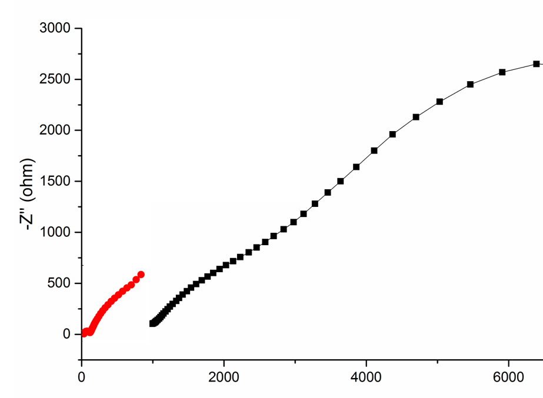
CONDUCTIVITY
TESTING
RESULTS
Hybrid CNT thread
Z_{Real} = 32.8 ohms
Z_{imaginary} (ohms)
Single CNT thread
Z_{Real} = 989 ohms
Z_{real} (ohms)
Notes:
Megan

Slide 19
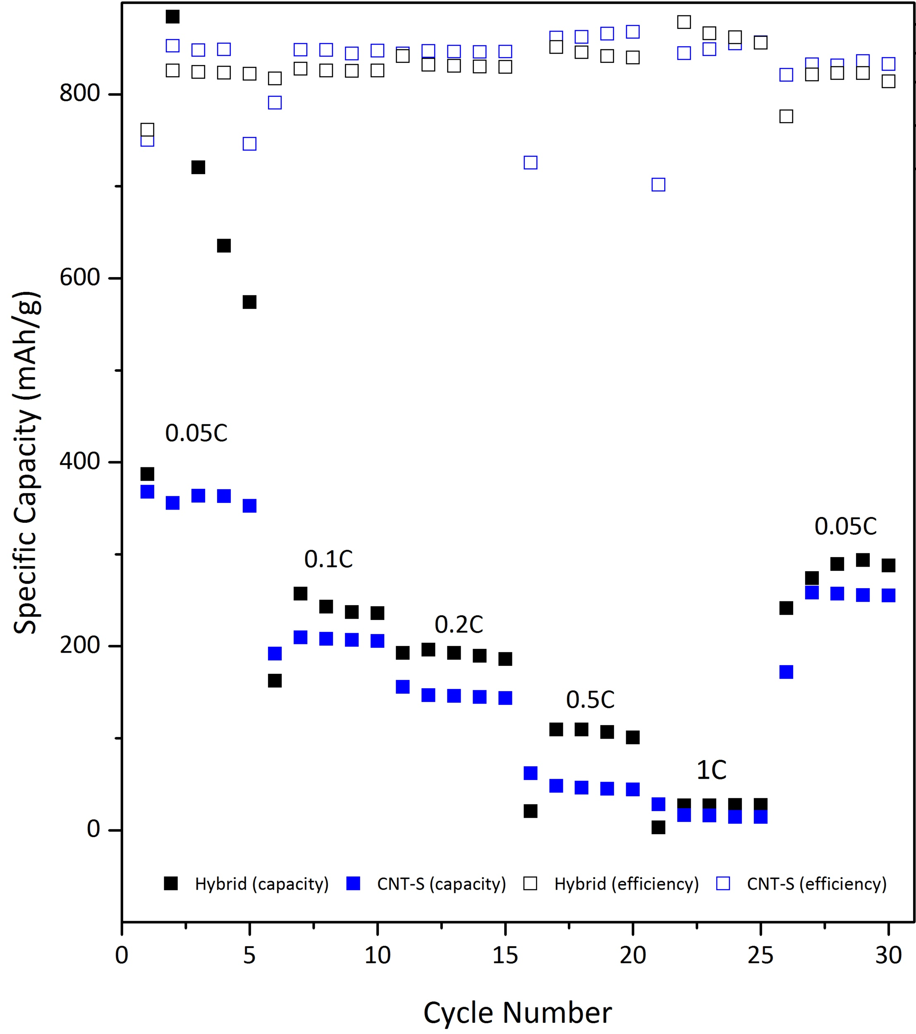
Battery Cycling Results
Overall higher capacity
Notes:
Aaron
Uses different charging frequencies to measure electrochemical cell properties: resistance and ion conductivity.

Slide 20
BIG IDEA
ESSENTIAL QUESTION
MEGAN’S
UNIT
ALGEBRA 2
DESIGN
CHALLENGE
1
2
Criteria for Optimal Battery Usage
How can we use math to illustrate the criteria for optimal battery use?
3
Use MacBooks to analyze battery consumption and graphically interpret data to create a set of criteria for ideal battery consumption.

Slide 21
BIG IDEA
ESSENTIAL QUESTION
AARON’S
UNIT
AP PHYSICS 2
DESIGN
CHALLENGE
EXTENSION PROJECT
1
2
Lithium-ion Batteries and Energy Storage
What can be done with all the rechargeable batteries which appear to have no usable life?
3
4
Design a process to test individual lithium-ion cells to determine which cells have more usable life and which cells will need to be recycled.
Build a small Li-ion battery back to charge a cell phone.
Notes:
Aaron

Slide 22
QUESTIONS?
RET is funded by the National Science Foundation, grant EEC #17110826
Notes:
Aaron

